Slide 1
8
GET READY!

Slide 2
Activity by Milton P. Jr.
www.upminds.wix.com/upminds
educationnow@yahoo.com.br

Slide 3
8

Slide 4
7

Slide 5
6

Slide 6
5

Slide 7
4

Slide 8
3

Slide 11
LET’S
START!

Slide 12
Match the ANTONYMS
excellent
second-rate
exciting
clichéd
funny
tragic
happy
dull
creative
sad
first class
average
intriguing
predictable

Slide 13
Match the SYNONYMS
expensive
violent
hilarious
shocking
humorous
funny
boring
amusing
surprising
tedious
bloody
costly
fast-moving
dynamic

Slide 14
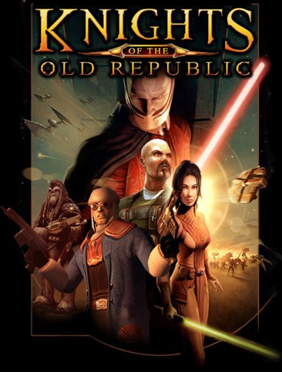
What’s the title of this film?
Milton P. Jr. educationnow@yahoo.com.br

Slide 15
What’s the title of this film?

Slide 16
What’s the title of this film?
Milton P. Jr. educationnow@yahoo.com.br

Slide 17
What’s the title of this film?

Slide 18
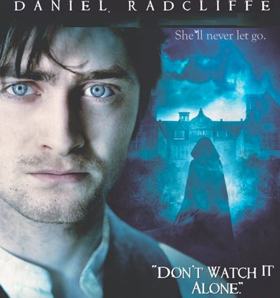
What’s the title of this film?
Milton P. Jr. educationnow@yahoo.com.br

Slide 19
What’s the title of this film?

Slide 20
What’s the title of this film?

Slide 21
What’s the title of this film?
Milton P. Jr. educationnow@yahoo.com.br

Slide 22
What’s the title of this film?

Slide 23
What’s the title of this film?
Milton P. Jr. educationnow@yahoo.com.br

Slide 24
Which cinema studio is this?

Slide 25
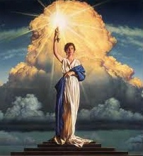
Which cinema studio is this?
Milton P. Jr. educationnow@yahoo.com.br

Slide 26
Which cinema studio is this?

Slide 27
Which cinema studio is this?
Milton P. Jr. educationnow@yahoo.com.br

Slide 28
Which cinema studio is this?

Slide 29
Which cinema studio is this?
Milton P. Jr. educationnow@yahoo.com.br

Slide 30
Which cinema studio is this?

Slide 31
NOW... Read the synopses and guess the film!
Milton P. Jr. educationnow@yahoo.com.br

Slide 32
It’s about a clownfish that travels across the ocean to find his son who was captured by a dentist. Along the way, the clownfish meets another fish with a memory problem. In the end, the two fish travel to Sydney, Australia and the little clownfish gets rescued.
Milton P. Jr. educationnow@yahoo.com.br

Slide 33
It’s about a princess who runs away from the palace because her evil stepmother wants to kill her. She finds a house in the forest where some dwarves live. However, the stepmother finds her, comes to the house disguised as an old woman, and gives her a poisoned apple. The dwarves chase the stepmother away, but it’s too late because the princess is already asleep because of the poison. In the end, a prince comes along and kisses her and she wakes up.

Slide 34
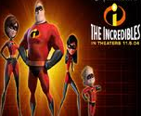
It’s about a family of superheroes who have to hide their identities and live normal lives. The dad gets bored living a normal life and takes a secret job as a superhero. But the job nearly kills him. His employer is in fact an evil genius who plans to take over the world. In the end, the superheroes save the planet form the evil genius.
Milton P. Jr. educationnow@yahoo.com.br

Slide 35
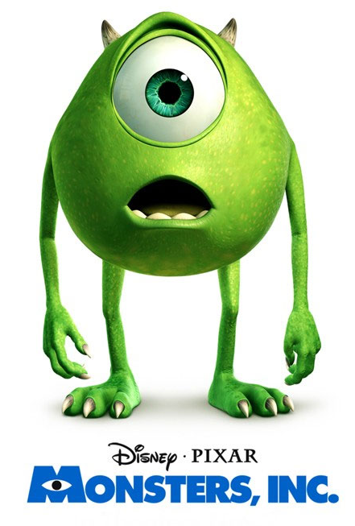
It’s about a society of monsters that generate electricity from children’s screams. One day a child follows the main characters back to the monster world, which causes a great deal of trouble. In the end, the monsters learn that they can generate more electricity from children’s laughs.

Slide 36
It’s about a boy who finds a lamp that seems to have superpower. It actually has a genie inside. The boy then uses his wishes to win the love of a princess. Unfortunately, an evil sorcerer steals the lamp and tries to kill the boy. In the end, the boy gets the lamp, wins the girl, and frees the genie.
Milton P. Jr. educationnow@yahoo.com.br

Slide 37
A boy experiences danger on board of a lifeboat after losing his whole family in a shipwreck . He has to negotiate a very small space with a large, ferocious tiger. But through it all, he remains determined and optimistic for he has his strong faith. In the end, he thanks God for his great experience.

Slide 38
I hope you have enjoyed it!
Milton P. Jr. educationnow@yahoo.com.br

