Slide 1
Project (part 1) Writing a Diary
Project 2 will be transforming your diary into a rhyme

Slide 2
Content
Application of past tense and active voice
Similes and Metaphors
Learn about the different kinds of Literary Devices
Diary Writing

Slide 3
Active vs Passive Voice
Active
Passive
Verb + Subject + Object
Subject + Verb + Object
Active voice emphasizes the subject acts upon a verb
Passive voice emphasizes the subject receiving the verb
Verb
(Passive Voice)
Subject
Subject
Verb
(Passive Voice)
A letter is received by him
A letter is received by him
He received a letter
A letter is received by him
He received a letter
He received a letter

Slide 4
Examples
Active
Passive
He received a letter
A letter is received by him
He has done the homework
The homework has been done by him
She made the cake
A cake was made by her
A dog ate the turkey
Our turkey was eaten by the dog
My brother fixed my computer
The computer was fixed by my brother

Slide 5
Simile
A simile is an expression used to describe something by comparing it to something else
Examples of similes
Like
As
He runs like the wind
As sweet as honey

Slide 6
We use “like” or “as”.
Simile
Examples:
He ran like a cat, lightly and quietly.

Slide 7
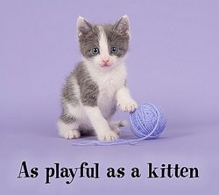
As busy as a bee
Simile - Examples

Slide 8
Similes
A Girl
The Sun
Yellow
Bright Smile
Yellow
Bright
Her (noun) is as (adjective) as/like the (noun)

Slide 9
Metaphor
is a comparison of two unlike things without using the words “like” or “as”
Examples:
He was a statue, waiting to hear the news.

Slide 10
Metaphor
It compares two things by saying one thing is the other thing
Examples of metaphors

Slide 11
Metaphor - Examples
My ___ is a big ____________
My mum is a big teddy bear

Slide 12
Literary Devices
Interesting when you read, useful when you write!

Slide 13
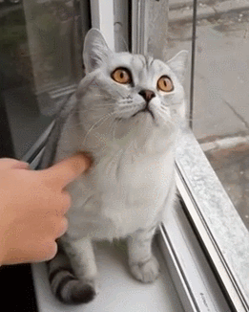
Imagery
is when a writer invokes the five senses.
Examples:
The smell reminded him of rotting tomatoes.
The fence was uneven, like baby teeth growing awkwardly in (also a simile!).

Slide 14
HYPERBOLE
Hyperbole
is an obvious exaggeration or overstatement.
Examples:
I’m so hungry I could eat a horse!

Slide 15
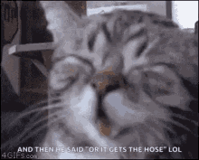
Personification
is when a writer gives human qualities to animals or objects.
Examples:
My car drank the gasoline in one gulp.
The cat laughed.
The newspaper headline glared at me.

Slide 16
Diary Writing
Requirements
Think of a memorable event
Use AT LEAST 2 literary devices
200 words
Use at least 2 Active and Passive tense sentences (a combination or one)

Slide 17
Sample Writing
Hyperbole
Personification
My first time riding the bus by myself
Have you ever worried about doing something alone before? That's how I felt last winter. It was my first time to travel alone somewhere. I was curiously excited but also worried.
My parents were busy that afternoon and I really wanted to visit my friend in Hongdae. It was as cold as ice outside but that didn’t stop me. I waited at the bus stop. The bus stopped and I remember the bus screaming as the wheels stopped. The lights on the bus glared at me before I got on.
I got on the bus and looked at the driver. The ticket was given to me and I gave him the money
Have you ever worried about doing something alone before? That's how I felt last winter. It was my first time to travel alone somewhere. I was curiously excited but also worried.
My parents were busy that afternoon and I really wanted to visit my friend in Hongdae. It was as cold as ice outside but that didn’t stop me. I waited at the bus stop. The bus stopped and I remember the bus screaming as the wheels stopped. The lights on the bus glared at me before I got on.
I got on the bus and looked at the driver. The ticket was given to me and I gave him the money
Have you ever worried about doing something alone before? That's how I felt last winter. It was my first time to travel alone somewhere. I was curiously excited but also worried.
My parents were busy that afternoon and I really wanted to visit my friend in Hongdae. It was as cold as ice outside but that didn’t stop me. I waited at the bus stop. The bus stopped and I remember the bus screaming as the wheels stopped. The lights on the bus glared at me before I got on.
I got on the bus and looked at the driver. The ticket was given to me and I gave him the money
Have you ever worried about doing something alone before? That's how I felt last winter. It was my first time to travel alone somewhere. I was curiously excited but also worried.
My parents were busy that afternoon and I really wanted to visit my friend in Hongdae. It was as cold as ice outside but that didn’t stop me. I waited at the bus stop. The bus stopped and I remember the bus screaming as the wheels stopped. The lights on the bus glared at me before I got on.
I got on the bus and looked at the driver. The ticket was given to me and I gave him the money
Passive voice
Active voice

Slide 18
Diary
Due for Monday

