Slide 1
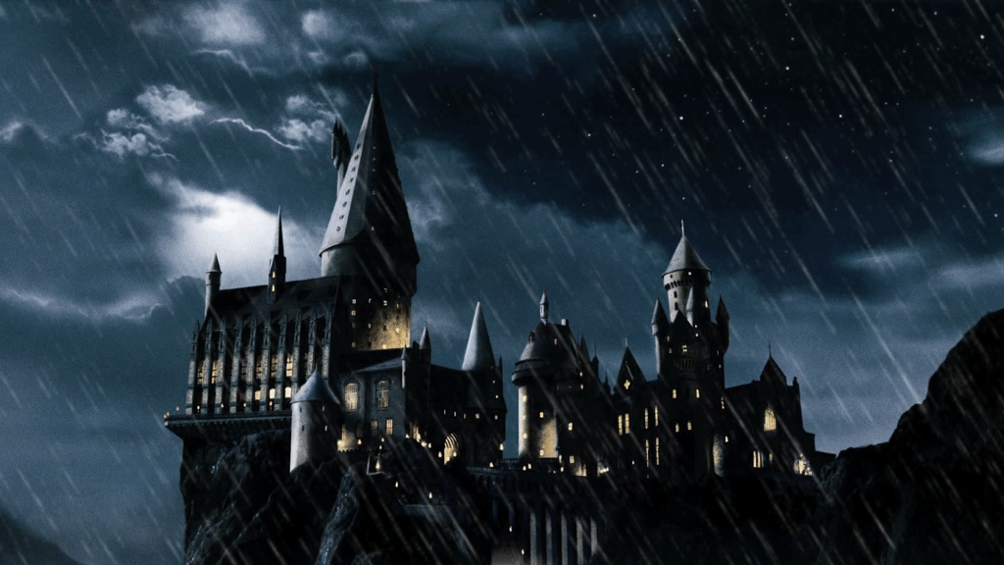

Slide 2
Dear Students of (Kyunghee Elementary School),
We are pleased to inform you that you have been accepted at Hogwarts School of
Witchcraft and Wizardry. Your English journey begins now. We await to see
which of you will become the top of your class by the end of this game.
Sincerely,
Notes:
Feel free to change the name of the school in the opening line as needed ☺

Slide 3
A
B
C
G
H
I
D
E
F
J
K
L
M
N
O
S
T
U
P
Q
R
V
W
X
Notes:
Click a letter to go to a question.

Slide 4
Question A
Instructions/Question here
Answer here
Notes:
Click the spacebar to make the ANSWER appear.
The blank space in the middle is for any extra text/images you need.
Click the green seal to go to the reward slide.
Click the red seal to go back to the question-choosing slide.

Slide 5
Question B
Instructions/Question here
Answer here
Notes:
Click the spacebar to make the ANSWER appear.
The blank space in the middle is for any extra text/images you need.
Click the green seal to go to the reward slide.
Click the red seal to go back to the question-choosing slide.

Slide 6
Question C
Instructions/Question here
Answer here
Notes:
Click the spacebar to make the ANSWER appear.
The blank space in the middle is for any extra text/images you need.
Click the green seal to go to the reward slide.
Click the red seal to go back to the question-choosing slide.

Slide 7
Question D
Instructions/Question here
Answer here
Notes:
Click the spacebar to make the ANSWER appear.
The blank space in the middle is for any extra text/images you need.
Click the green seal to go to the reward slide.
Click the red seal to go back to the question-choosing slide.

Slide 8
Question E
Instructions/Question here
Answer here
Notes:
Click the spacebar to make the ANSWER appear.
The blank space in the middle is for any extra text/images you need.
Click the green seal to go to the reward slide.
Click the red seal to go back to the question-choosing slide.

Slide 9
Question F
Instructions/Question here
Answer here
Notes:
Click the spacebar to make the ANSWER appear.
The blank space in the middle is for any extra text/images you need.
Click the green seal to go to the reward slide.
Click the red seal to go back to the question-choosing slide.

Slide 10
Question G
Instructions/Question here
Answer here
Notes:
Click the spacebar to make the ANSWER appear.
The blank space in the middle is for any extra text/images you need.
Click the green seal to go to the reward slide.
Click the red seal to go back to the question-choosing slide.

Slide 11
Question H
Instructions/Question here
Answer here
Notes:
Click the spacebar to make the ANSWER appear.
The blank space in the middle is for any extra text/images you need.
Click the green seal to go to the reward slide.
Click the red seal to go back to the question-choosing slide.

Slide 12
Question I
Instructions/Question here
Answer here
Notes:
Click the spacebar to make the ANSWER appear.
The blank space in the middle is for any extra text/images you need.
Click the green seal to go to the reward slide.
Click the red seal to go back to the question-choosing slide.

Slide 13
Question J
Instructions/Question here
Answer here
Notes:
Click the spacebar to make the ANSWER appear.
The blank space in the middle is for any extra text/images you need.
Click the green seal to go to the reward slide.
Click the red seal to go back to the question-choosing slide.

Slide 14
Question K
Instructions/Question here
Answer here
Notes:
Click the spacebar to make the ANSWER appear.
The blank space in the middle is for any extra text/images you need.
Click the green seal to go to the reward slide.
Click the red seal to go back to the question-choosing slide.

Slide 15
Question L
Instructions/Question here
Answer here
Notes:
Click the spacebar to make the ANSWER appear.
The blank space in the middle is for any extra text/images you need.
Click the green seal to go to the reward slide.
Click the red seal to go back to the question-choosing slide.

Slide 16
Question M
Instructions/Question here
Answer here
Notes:
Click the spacebar to make the ANSWER appear.
The blank space in the middle is for any extra text/images you need.
Click the green seal to go to the reward slide.
Click the red seal to go back to the question-choosing slide.

Slide 17
Question N
Instructions/Question here
Answer here
Notes:
Click the spacebar to make the ANSWER appear.
The blank space in the middle is for any extra text/images you need.
Click the green seal to go to the reward slide.
Click the red seal to go back to the question-choosing slide.

Slide 18
Question O
Instructions/Question here
Answer here
Notes:
Click the spacebar to make the ANSWER appear.
The blank space in the middle is for any extra text/images you need.
Click the green seal to go to the reward slide.
Click the red seal to go back to the question-choosing slide.

Slide 19
Question P
Instructions/Question here
Answer here
Notes:
Click the spacebar to make the ANSWER appear.
The blank space in the middle is for any extra text/images you need.
Click the green seal to go to the reward slide.
Click the red seal to go back to the question-choosing slide.

Slide 20
Question Q
Instructions/Question here
Answer here
Notes:
Click the spacebar to make the ANSWER appear.
The blank space in the middle is for any extra text/images you need.
Click the green seal to go to the reward slide.
Click the red seal to go back to the question-choosing slide.

Slide 21
Question R
Instructions/Question here
Answer here
Notes:
Click the spacebar to make the ANSWER appear.
The blank space in the middle is for any extra text/images you need.
Click the green seal to go to the reward slide.
Click the red seal to go back to the question-choosing slide.

Slide 22
Question S
Instructions/Question here
Answer here
Notes:
Click the spacebar to make the ANSWER appear.
The blank space in the middle is for any extra text/images you need.
Click the green seal to go to the reward slide.
Click the red seal to go back to the question-choosing slide.

Slide 23
Question T
Instructions/Question here
Answer here
Notes:
Click the spacebar to make the ANSWER appear.
The blank space in the middle is for any extra text/images you need.
Click the green seal to go to the reward slide.
Click the red seal to go back to the question-choosing slide.

Slide 24
Question U
Instructions/Question here
Answer here
Notes:
Click the spacebar to make the ANSWER appear.
The blank space in the middle is for any extra text/images you need.
Click the green seal to go to the reward slide.
Click the red seal to go back to the question-choosing slide.

Slide 25
Question V
Instructions/Question here
Answer here
Notes:
Click the spacebar to make the ANSWER appear.
The blank space in the middle is for any extra text/images you need.
Click the green seal to go to the reward slide.
Click the red seal to go back to the question-choosing slide.

Slide 26
Question W
Instructions/Question here
Answer here
Notes:
Click the spacebar to make the ANSWER appear.
The blank space in the middle is for any extra text/images you need.
Click the green seal to go to the reward slide.
Click the red seal to go back to the question-choosing slide.

Slide 27
Question X
Instructions/Question here
Answer here
Notes:
Click the spacebar to make the ANSWER appear.
The blank space in the middle is for any extra text/images you need.
Click the green seal to go to the reward slide.
Click the red seal to go back to the question-choosing slide.

Slide 28
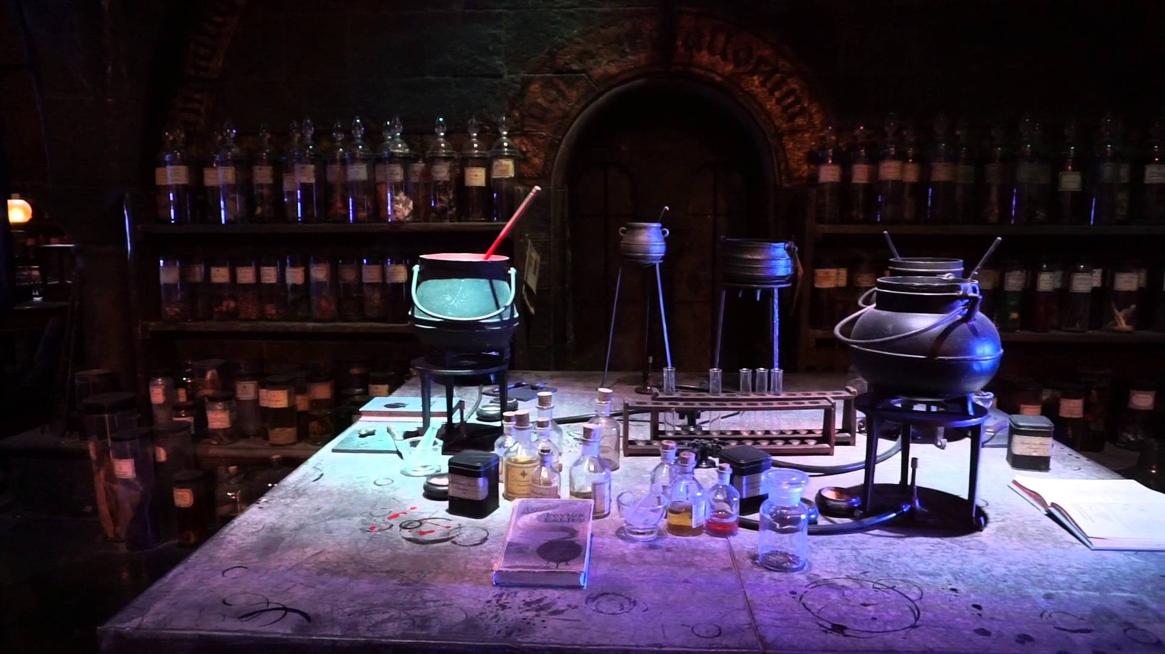
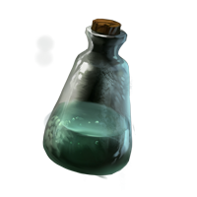
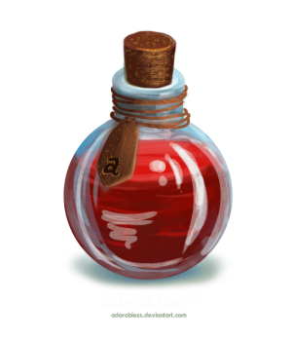
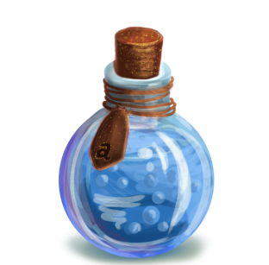
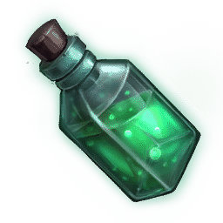
Reward A
Mix as many potions as you want for points, but if your spell explodes, you get nothing!
Notes:
Click the potions to “add” them to the cauldron.
Behind each potion is a point score or nothing (nothing = 0 points)
Ask the students if they want to keep the points they have or choose another potion for more points, but at the risk of the spell exploding.
Repeat that process until they either decide to keep the points they have and stop adding potions or the spell explodes.
If the spell explodes, they get 0 points.
Click the Hogwarts icon to go back the question-choosing slide.

Slide 29
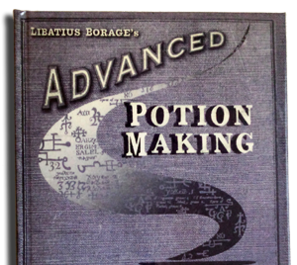
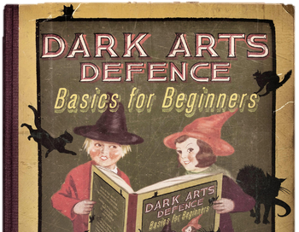
Reward C
Buy some school supplies (1 of each)…
Notes:
Click an item to make a reward/penalty appear.
Students have to choose one of each item (3 items total).
If they find a bomb (the Death Eater icon), they lose the points they earned and cannot continue choosing items.
If there’s nothing behind an object, that means 0 points/no points added the total. A number is the number of points.
Click the Hogwarts icon to go back the question-choosing slide.

Slide 30
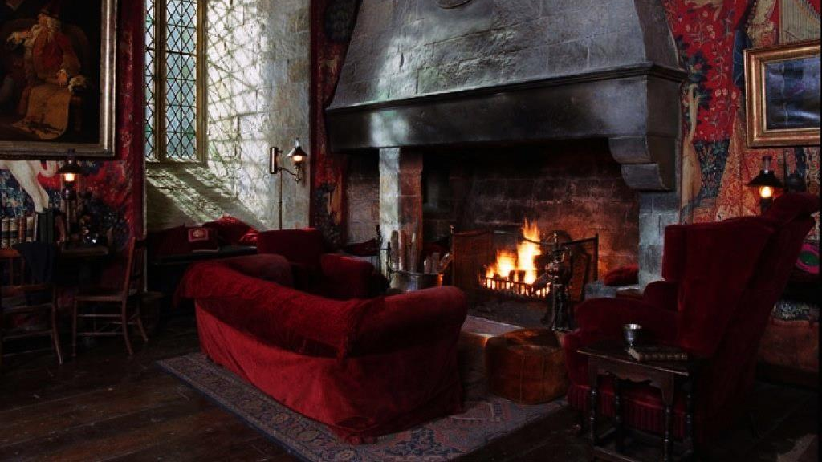
Reward D
Choose your best friend…
Notes:
Click a character to reveal a reward/penalty.
Click the Hogwarts icon to go back the question-choosing slide.

Slide 31
Reward E
1
2
3
4
5
A
B
Open 4 boxes!
C
D
+1
+2
+3
E
F
+4
Bomb!
Notes:
Click a box to reveal a reward/penalty.
Students choose 4 boxes.
If they find a bomb (Pepper Imps candy), they lose the points they earned and cannot continue choosing boxes.
Point values are indicated on the right.
Click the Hogwarts icon to go back the question-choosing slide.

Slide 32
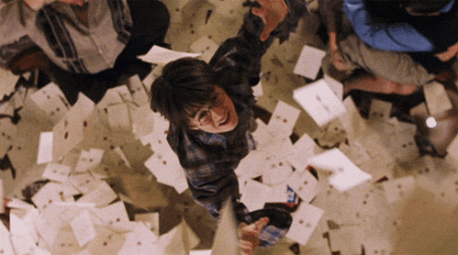
Reward F Question
You finally get your letter from Hogwarts!
Notes:
Click “A” or “B” to reveal a reward/penalty.

Slide 33
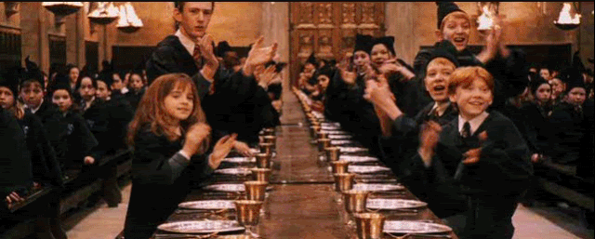
Reward F - A
Welcome to Hogwarts!
Notes:
Click the Hogwarts icon to go back the question-choosing slide.

Slide 34
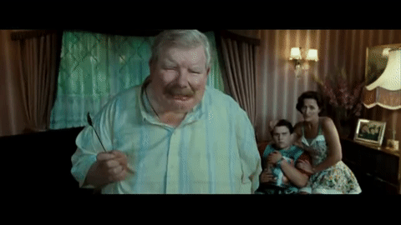
Reward F - B
You were caught by the Dursleys!
Notes:
Click the Hogwarts icon to go back the question-choosing slide.

Slide 35
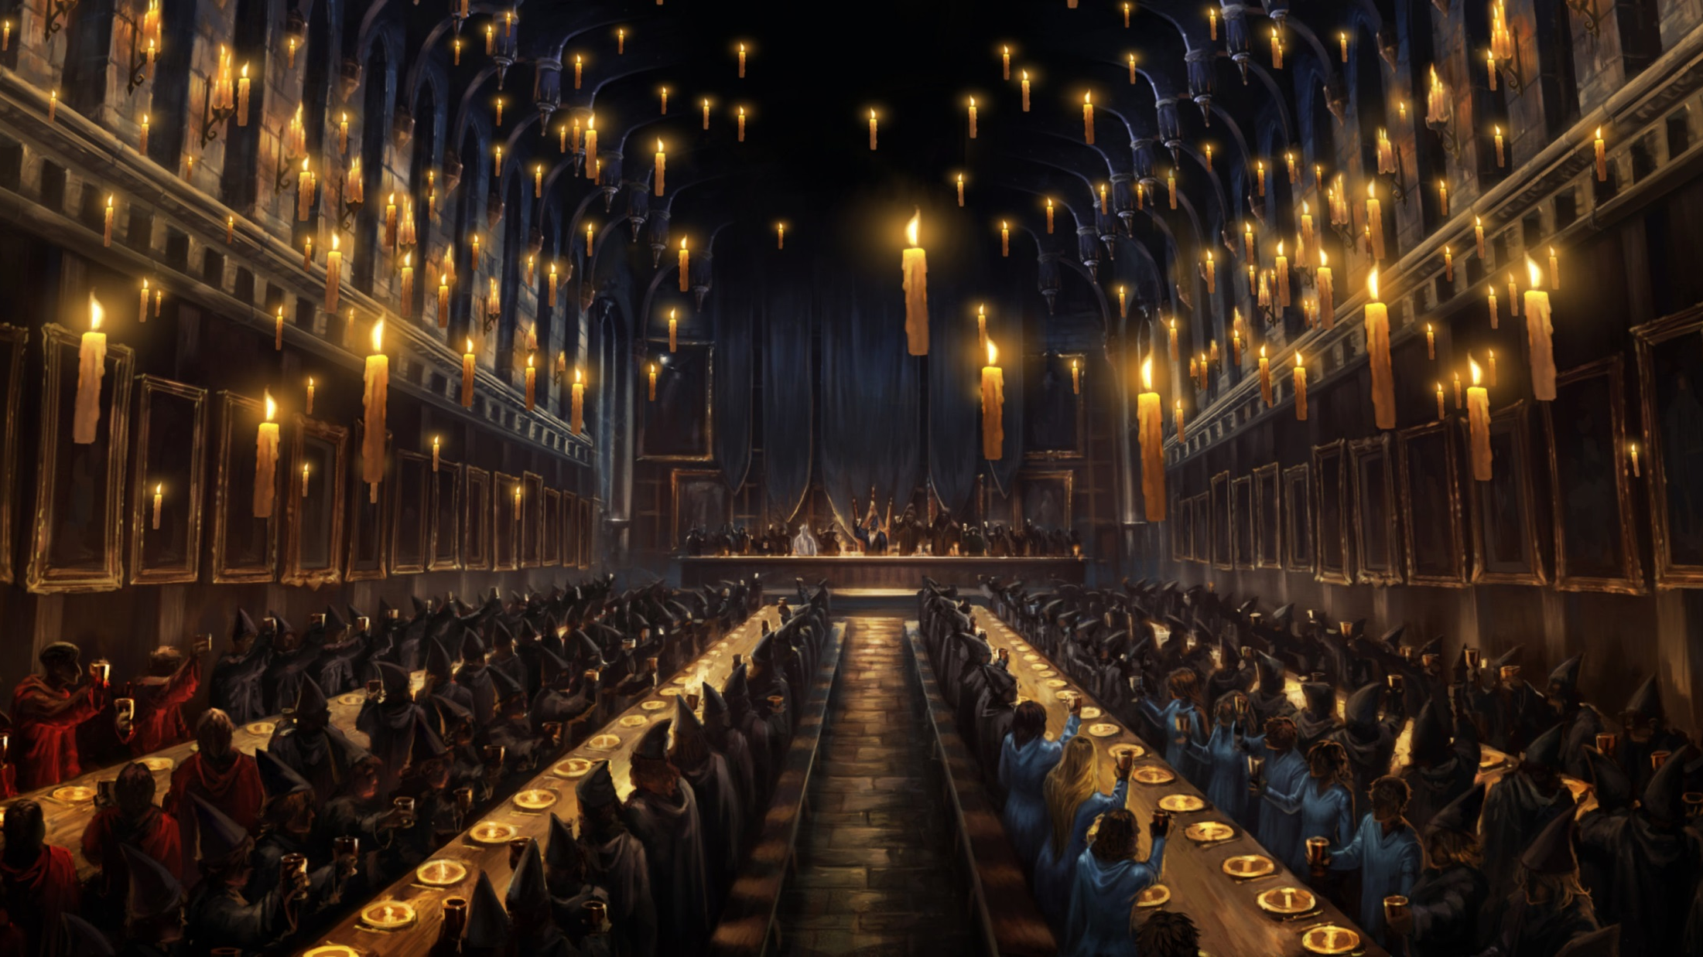
Reward G
Notes:
Click a sorting hat to reveal a reward/penalty.
Students choose 4 sorting hats.
If they find a bomb (the Death Eater icon), they lose the points they earned and cannot continue choosing hats.
Point values are indicated on the right.
Click the Hogwarts icon to go back the question-choosing slide.

Slide 36
Reward H
Choose someone to duel…
Notes:
Click a character to reveal a reward/penalty.
Click the Hogwarts icon to go back the question-choosing slide.

Slide 37
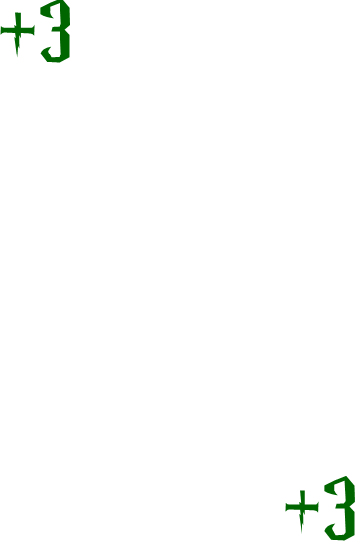
Reward I
Test your luck!
Keep the card you have or draw more for more points. But beware! If you find a bomb the game is over and you lose all your points.
Notes:
Click the cards to make a reward appear.
Ask the students if they want to keep the reward or click again to add more points, but at the risk of finding a bomb.
Repeat that process until they either decide to keep their points, or reach the BOMB! card.
Click the Hogwarts icon to go back the question-choosing slide.

Slide 38
Reward J Question
Your rival challenges you to a duel.
Notes:
Click “A” or “B” to reveal a reward/penalty.

Slide 39
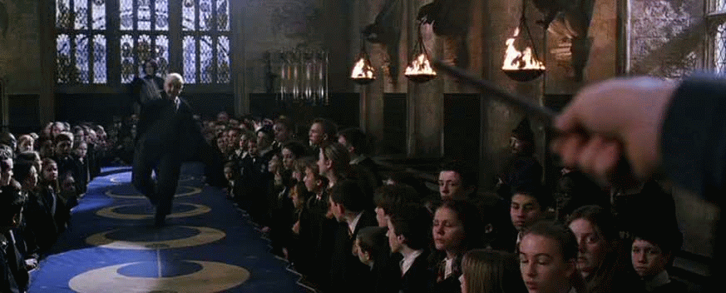
Reward J - B
You lost!
Notes:
Click the Hogwarts icon to go back the question-choosing slide.

Slide 40
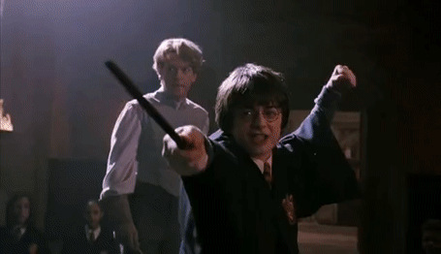
Reward J - A
You won!
Notes:
Click the Hogwarts icon to go back the question-choosing slide.

Slide 41
Reward L
Take down 3 posters….
Notes:
Click a poster to reveal a reward/penalty.
Students choose 3 posters.
If they find a bomb (the Death Eater icon), they lose the points they earned and cannot continue choosing posters.
If there’s nothing behind a poster, that means 0 points/no points added the total. A number is the number of points.
Click the Hogwarts icon to go back the question-choosing slide.

Slide 42
Reward M Question
Voldemort attacks!
Notes:
Click “A” or “B” to reveal a reward/penalty.

Slide 43
Reward M - B
You won!
Notes:
Click the Hogwarts icon to go back the question-choosing slide.

Slide 44
Reward M - A
You lost!
Notes:
Click the Hogwarts icon to go back the question-choosing slide.

Slide 45
Reward N
Choose 3 classes to take…
Muggle Studies
History of Magic
Potions
Divination
Astronomy
Defense Against Dark Arts
Magical Theory
Care of Magical Creatures
Charms
Herbology
Notes:
Click a book to reveal a reward/penalty.
Students choose 3 books.
If they find a bomb (the Death Eater icon), they lose the points they earned and cannot continue choosing books.
If there’s nothing behind a book, that means 0 points/no points added the total. A number is the number of points.
Click the Hogwarts icon to go back the question-choosing slide.

Slide 46
Reward O
1
2
3
4
5
A
B
Open 4 boxes!
C
D
+1
+2
+3
E
F
+4
Bomb!
Notes:
Click a box to reveal a reward/penalty.
Students choose 4 boxes.
If they find a bomb (Pepper Imps candy), they lose the points they earned and cannot continue choosing boxes.
Point values are indicated on the right.
Click the Hogwarts icon to go back the question-choosing slide.

Slide 47
Reward P
Choose your pet owl…
Notes:
Click an owl to reveal a reward/penalty.
Click the Hogwarts icon to go back the question-choosing slide.

Slide 48
Reward R
Mix as many potions as you want for points, but if your spell explodes, you get nothing!
Notes:
Click the potions to “add” them to the cauldron.
Behind each potion is a point score or nothing (nothing = 0 points)
Ask the students if they want to keep the points they have or choose another potion for more points, but at the risk of the spell exploding.
Repeat that process until they either decide to keep the points they have and stop adding potions or the spell explodes.
If the spell explodes, they get 0 points.
Click the Hogwarts icon to go back the question-choosing slide.

Slide 49
Reward S
Choose your Patronus…
Notes:
Click a Patronus to reveal a reward/penalty.
Click the Hogwarts icon to go back the question-choosing slide.

Slide 50
Reward T
Test your luck!
Keep the card you have or draw more for more points. But beware! If you find a bomb the game is over and you lose all your points.
Notes:
Click the cards to make a reward appear.
Ask the students if they want to keep the reward or click again to add more points, but at the risk of finding a bomb.
Repeat that process until they either decide to keep their points, or reach the BOMB! card.
Click the Hogwarts icon to go back the question-choosing slide.

Slide 51
Reward U
Cast Wingardium Leviosa on 3 bowls to reveal your points…
1
2
3
4
5
6
7
8
9
10
11
12
Notes:
Click a bowl to make a reward/penalty appear.
Students choose 3 bowls.
If they find a bomb (the Death Eater icon), they lose the points they earned and cannot continue choosing bowls.
If there’s nothing under a bowl, that means 0 points/no points added the total. A number is the number of points.
Click the Hogwarts icon to go back the question-choosing slide.

Slide 52
Reward W Question
You find a hippogriff in the forest.
Notes:
Click “A” or “B” to reveal a reward/penalty.

Slide 53
Reward W - A
It sees you as a friend!
Notes:
Click the Hogwarts icon to go back the question-choosing slide.

Slide 54
Reward W - B
It sees you as an enemy!
Notes:
Click the Hogwarts icon to go back the question-choosing slide.

Slide 55
Reward X
Notes:
Click a sorting hat to reveal a reward/penalty.
Students choose 4 sorting hats.
If they find a bomb (the Death Eater icon), they lose the points they earned and cannot continue choosing hats.
Point values are indicated on the right.
Click the Hogwarts icon to go back the question-choosing slide.

Slide 56
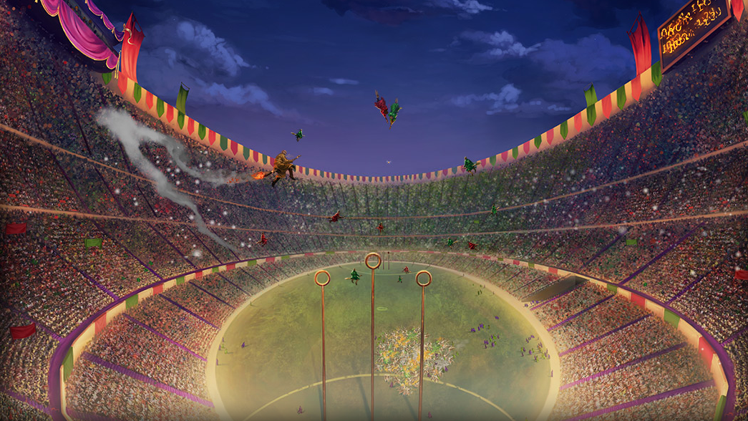
Reward B, K, Q, V
Catch the golden snitch for 10pts!
Notes:
Click the wheel to spin it.
The golden snitch is worth 10pts and the Death Eater icon is worth 0pts.
Click the Hogwarts icon to go back the question-choosing slide.

